Slide 1
A cup of tea
The temperature of a cup of tea is measured with a thermometer.
There is a red liquid inside this thermometer.
Tea

Slide 2
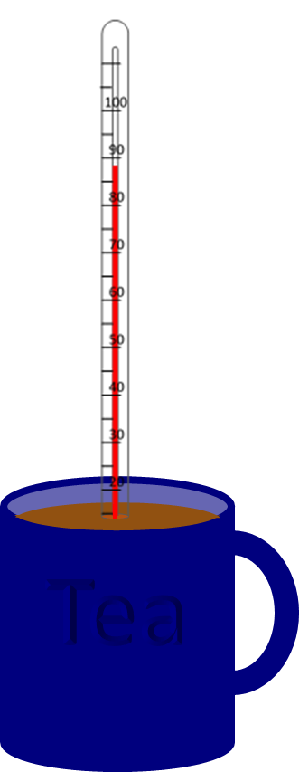
A cup of tea
What happens to the liquid in the thermometer when it is put in the hot tea?
A
Its temperature goes up and it expands (gets bigger)
B
Its temperature goes up
C
Its temperature goes up and it contracts (gets smaller)

Slide 3
A cup of tea
What is the best answer that explains why this happens?
A
The particles move more quickly
B
The particles expand (get bigger)
C
The particles break up
D
The temperature of each particle goes up

